Slide 1
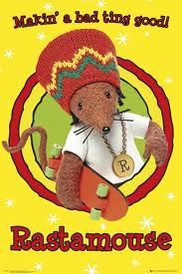
Making a bad ting good: Hybridity and Authenticity in the BBC’s Rastamouse children’s series

Slide 2
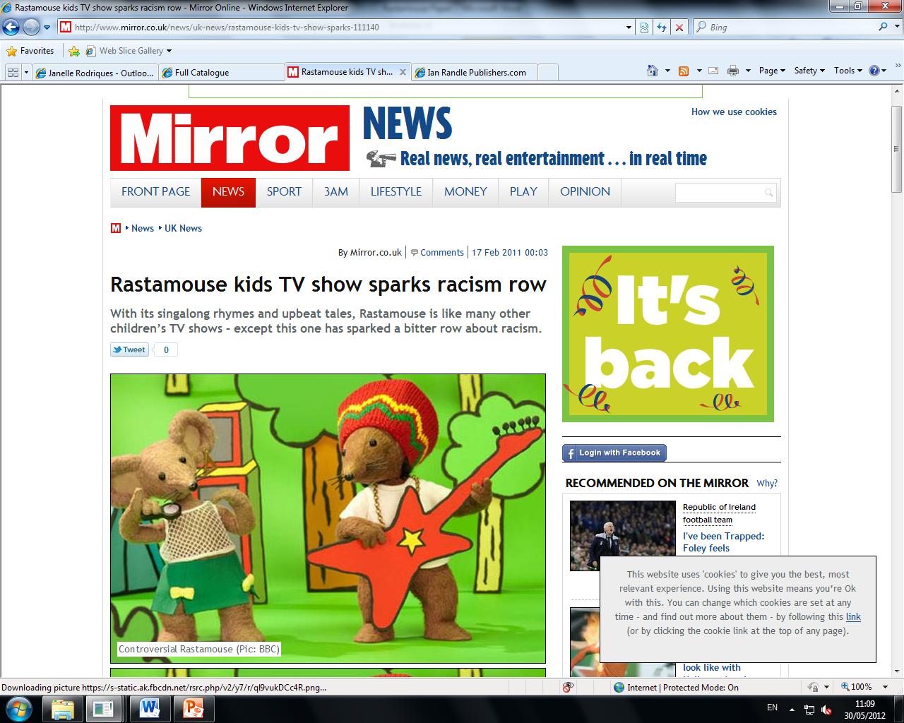

Slide 3
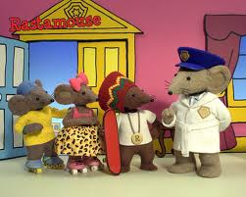
Rastamouse "Da Missing Masterpiece" Clip (Official) - YouTube

Slide 4
The Rastamouse books are written in Afro-Caribbean Patois rhyme and this authentic voice has been transferred to the TV series to retain its heart, integrity and distinctive quality. Rastamouse is part of a rich and varied CBeebies schedule, which is dedicated to reflecting the lives of all children in this country. Although Rastamouse has a particular appeal to young Afro-Caribbean children, its entertaining stories and positive messages - about friendship, respect and community - are intended to be enjoyed by all our young viewers, regardless of their backgrounds.
Jonathan Wynne-Jones and Jasper Copping, Daily Telegraph, ‘Rastamouse provokes complaints of racism and teaching bad language’ (12 February 2011).

Slide 5
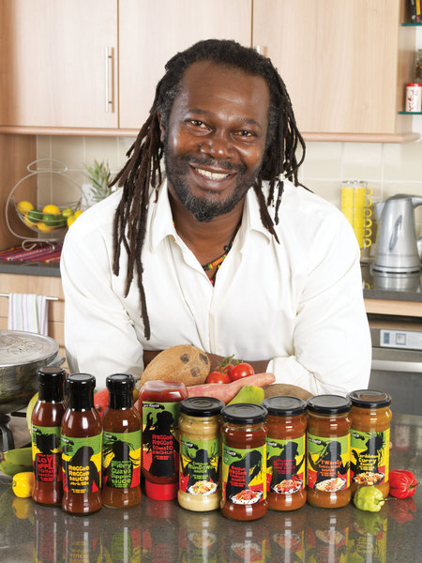
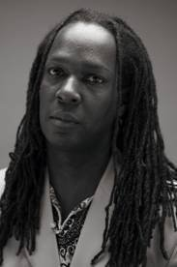


Slide 6
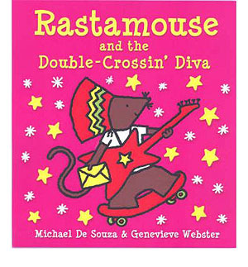
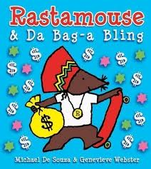

Slide 7
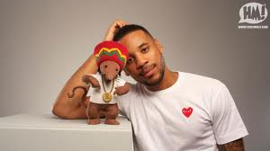

Slide 8
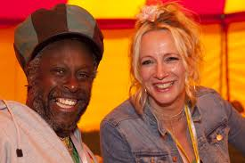
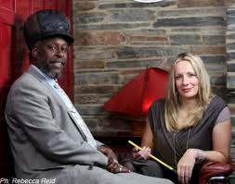

Slide 9
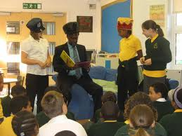

Slide 10
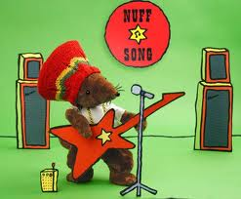
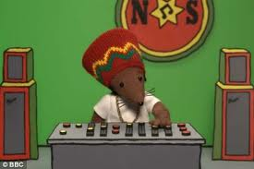

Slide 11
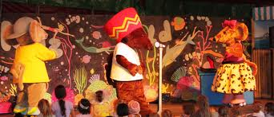

Slide 12
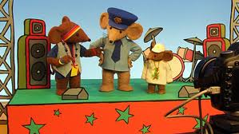

Slide 13
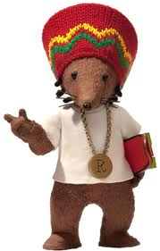

Slide 14
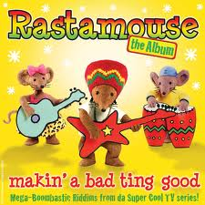
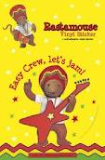

Slide 15
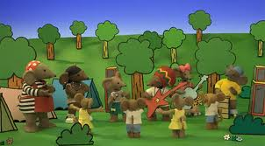

Slide 16
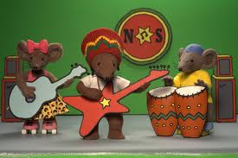

Slide 17
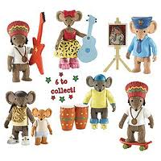

Slide 18
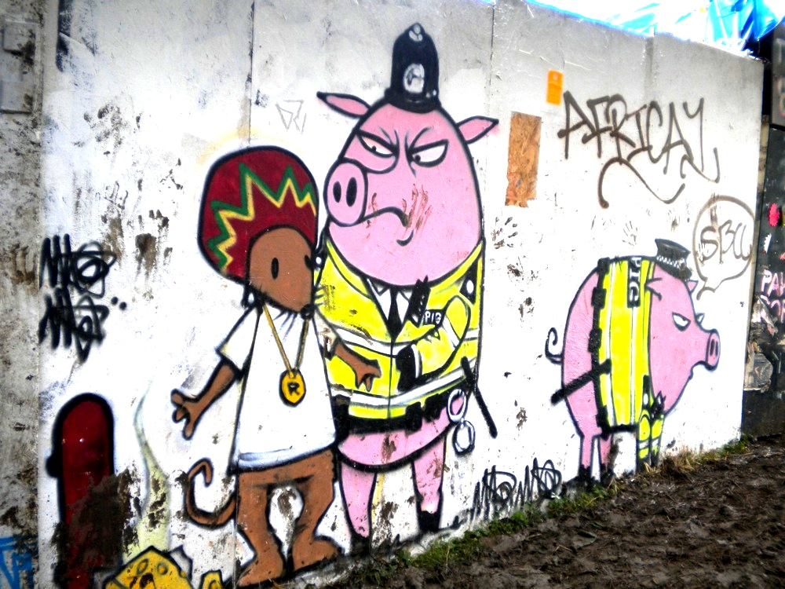

Slide 19
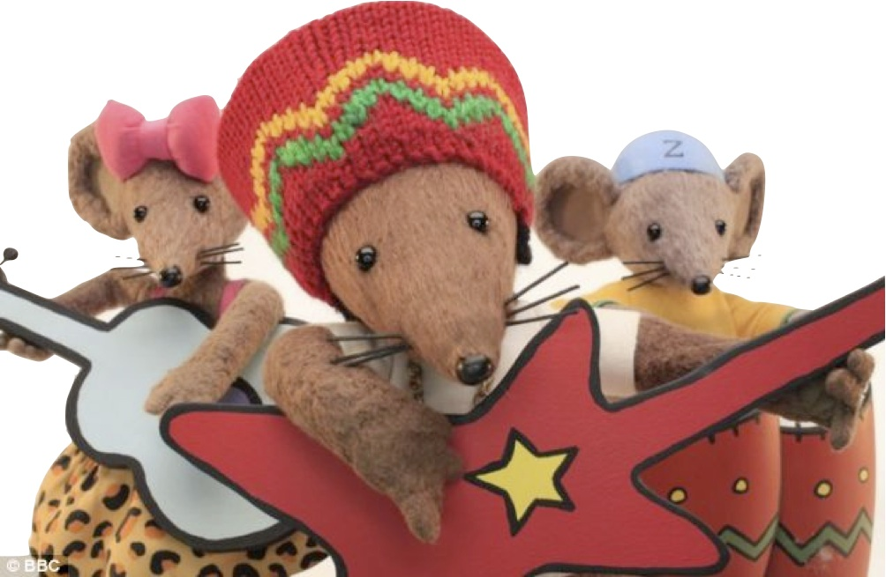
Janelle Rodriques, Newcastle University
j.rodriques@newcastle.ac.uk

